Slide 1
Predicting loan charge-offs
For this project, I will be analyzing Lending Club loan data to model loan charge-offs.
Lending Club is a peer-to-peer lending platform in which investors lend money directly to people who are seeking unsecured loans.
They make their loan data public on an annual basis and their dataset contains many features. I chose a handful that should predict whether A loan is charged off or not, i.e. a loan is either eventually fully paid off or "charged off' which means that the full amount of the loan is deemed uncollectable by Lending Club.

Slide 2
All columns
id', 'member_id', 'loan_amnt', 'funded_amnt', 'funded_amnt_inv', 'term', 'int_rate', 'installment', 'grade’,
'sub_grade', 'emp_title', 'emp_length', 'home_ownership', 'annual_inc’,
'verification_status', 'issue_d', 'loan_status', 'pymnt_plan', 'url', 'desc’,
'purpose', 'title', 'zip_code', 'addr_state', 'dti', 'delinq_2yrs', 'earliest_cr_line’,
'fico_range_low', 'fico_range_high', 'inq_last_6mths', 'mths_since_last_delinq’,
'mths_since_last_record', 'open_acc', 'pub_rec', 'revol_bal', 'revol_util', 'total_acc’,
'initial_list_status', 'out_prncp', 'out_prncp_inv', 'total_pymnt', 'total_pymnt_inv’,
'total_rec_prncp', 'total_rec_int', 'total_rec_late_fee', 'recoveries', 'collection_recovery_fee’,
'last_pymnt_d', 'last_pymnt_amnt', 'next_pymnt_d', 'last_credit_pull_d', 'last_fico_range_high’,
'last_fico_range_low', 'collections_12_mths_ex_med', 'mths_since_last_major_derog', 'policy_code’,
'application_type', 'annual_inc_joint', 'dti_joint', 'verification_status_joint', 'acc_now_delinq’,
'tot_coll_amt', 'tot_cur_bal', 'open_acc_6m', 'open_il_6m', 'open_il_12m', 'open_il_24m’,
'mths_since_rcnt_il', 'total_bal_il', 'il_util', 'open_rv_12m', 'open_rv_24m', 'max_bal_bc’,
'all_util', 'total_rev_hi_lim', 'inq_fi', 'total_cu_tl', 'inq_last_12m', 'acc_open_past_24mths’,
'avg_cur_bal', 'bc_open_to_buy', 'bc_util', 'chargeoff_within_12_mths', 'delinq_amnt', 'mo_sin_old_il_acct’,
'mo_sin_old_rev_tl_op', 'mo_sin_rcnt_rev_tl_op', 'mo_sin_rcnt_tl', 'mort_acc', 'mths_since_recent_bc’,
'mths_since_recent_bc_dlq', 'mths_since_recent_inq', 'mths_since_recent_revol_delinq', 'num_accts_ever_120_pd’,
'num_actv_bc_tl', 'num_actv_rev_tl', 'num_bc_sats', 'num_bc_tl', 'num_il_tl', 'num_op_rev_tl', 'num_rev_accts’,
'num_rev_tl_bal_gt_0', 'num_sats', 'num_tl_120dpd_2m', 'num_tl_30dpd', 'num_tl_90g_dpd_24m', 'num_tl_op_past_12m’,
'pct_tl_nvr_dlq', 'percent_bc_gt_75', 'pub_rec_bankruptcies', 'tax_liens', 'tot_hi_cred_lim', 'total_bal_ex_mort’,
'total_bc_limit', 'total_il_high_credit_limit', 'revol_bal_joint', 'sec_app_fico_range_low’,
'sec_app_fico_range_high', 'sec_app_earliest_cr_line', 'sec_app_inq_last_6mths', 'sec_app_mort_acc’,
'sec_app_open_acc', 'sec_app_revol_util', 'sec_app_open_il_6m', 'sec_app_num_rev_accts’,
'sec_app_chargeoff_within_12_mths', 'sec_app_collections_12_mths_ex_med', 'sec_app_mths_since_last_major_derog']

Slide 3
Features
FICO scores.
01
length of employment.
02
the interest rate charged on the loan.
03
Annual income of borrower.
04
Amount borrowed.
05
All features were continuous variables.
06

Slide 4
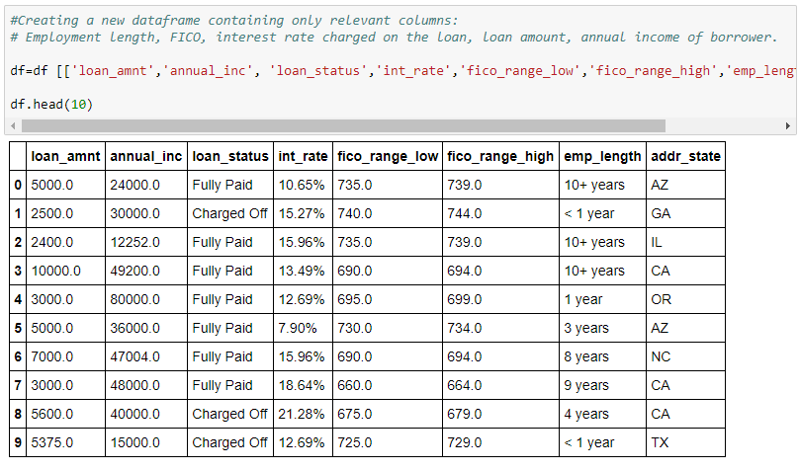
First, Let’s whittle down the Columns

Slide 5


Next, let’s munge the Data!
The interest rate was changed to an integer
Fico high and low were averaged
Loan status was changed to 1 for charged off and 0 for fully paid
Employment length was also converted to an int

Slide 6

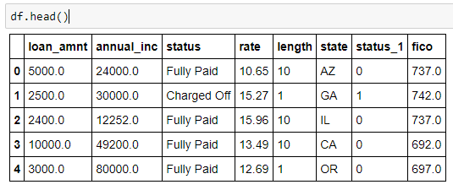
VOILA!

Slide 7
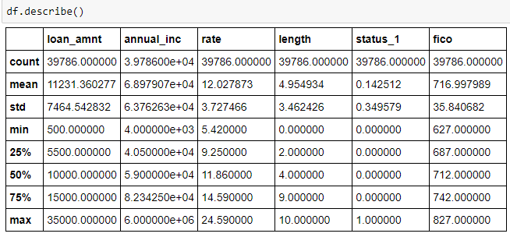
Some info on the dataset
Average values:
Loan amount: $11,231
Annual Income: $69,000
Interest rate: 12%
Length of employment: 5 yrs
FICO: 716

Slide 8
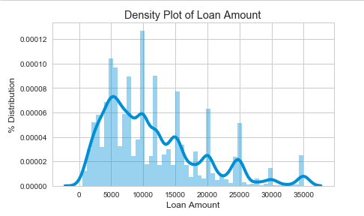
Most loans were from $2500 - $10k

Slide 9
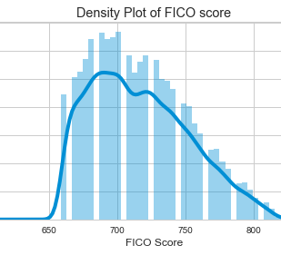
Most fico scores ranged from 670 -750
Prime credit scores are considered 680 and above
Lending club is pretty selective in that they only approve mostly prime borrowers

Slide 10
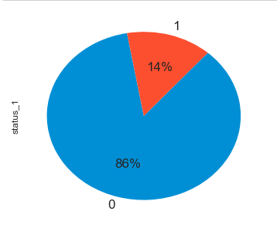
Distribution of Loan status
Loan status was classified as either fully paid or charged off.
86% of all loans in the dataset were fully paid.
14% were charged off.
Nan’s were disregarded.

Slide 11
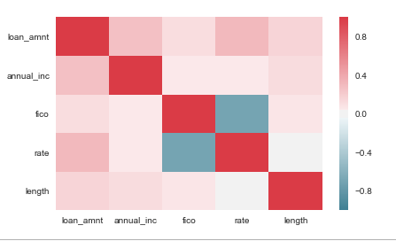
Data analysis
Heat map of features shows low multicollinearity

Slide 12
Logistic Regression
Results

Slide 13
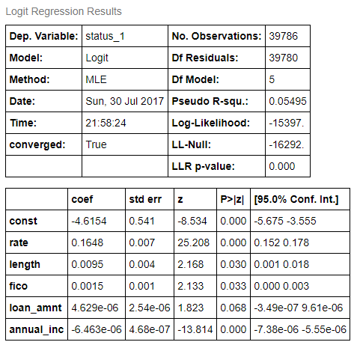
Results
Logistic regression
Low r-squared
Minimal or negative coefficients reflect low impact on outcome

Slide 14

ROC?
"Receiver Operating Characteristic”
ROC analysis is part of a field called "Signal Detection Theory" developed during World War II for the analysis of radar images.
Radar operators had to decide whether a blip on the screen represented an enemy target, a friendly ship, or just noise.
Signal detection theory measures the ability of radar receiver operators to make these important distinctions. Their ability to do so was called the Receiver Operating Characteristics.
It was not until the 1970's that signal detection theory was recognized as useful for interpreting medical test results.
-University of Nebraska Medical Center

Slide 15
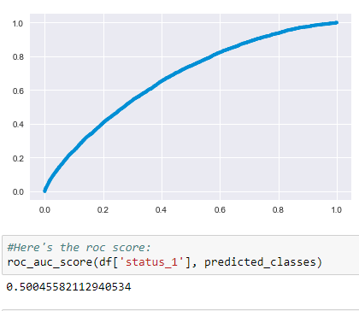
ROC
ROC fared very badly as well.
AUC was .50 which implies that the model was no better than chance at predicting loan charge-offs.

Slide 16
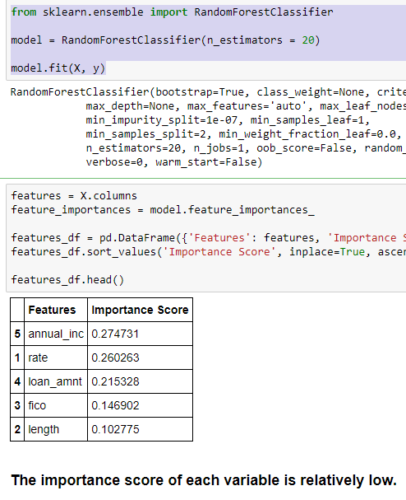
reSULTS OF Random Forest and Cross validation

Slide 17
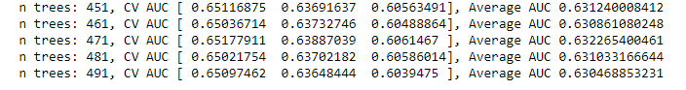

Random forest at n=500

Slide 18
Lessons learned
Annual income, FICO score, length of employment, rate charged on loan and amount borrowed should have intuitively predicted which loans would be charged off or fully paid.
The more one makes, the easier it is to pay off debt or the better the credit score, the better the credit risk.

Slide 19
What happened?
In considering why the model failed, it seems likely that I did not have enough features despite low multicollinearity among them.
There must be more subtle factors at work. For future work, I would incorporate as many features as possible and then perhaps let the machine learning algo pick the ones that have some predictive power.
In studying some other people's work, this seems like the best choice.

Slide 20
Lessons learned
Earlier in the course, I kept saying to myself, you could just do this in MS Excel and not have to write much code.
Now, I see how wrong I was. Try simply loading this Lending Club dataset into Excel and I'll see you in about five minutes.
After learning a bit of pandas, I have come to see the power of dataframes and python. When dealing with data, you need the best tools.

Slide 21

Another Lesson
Unexpectedly, cleaning the dataset and getting it into a form that I can work with was immensely satisfying. The preprocessing code was a challenge at first, but with each step, from choosing the columns to changing the object type, I could see the raw data come to life and it became my own.
This Photo by Unknown Author is licensed under CC BY

Slide 22

Data…
data is Mount Everest. scraping off and polishing a boulder from its base is rewarding, no matter how small.
Much like your first love, what is done after polishing the stone can yield both frustration and elation.
I will continue my climb!
This Photo by Unknown Author is licensed under CC BY-SA

